Slide 1
ITNW 1335 Cloud Computing
Chapter 8 – Specialized Cloud Mechanisms

Slide 2
Specialized Cloud Mechanisms
A typical cloud technology architecture contains numerous moving parts to address distinct usage requirements of IT resources and solutions.
Each mechanism covered fulfills a specific runtime function in support of one or more cloud characteristics.
The following specialized cloud mechanisms are:
Automated Scaling Listener
Load Balancer
SLA Monitor
Pay-Per-Use Monitor
Audit Monitor
Failover System
Hypervisor
Resource Cluster
Multi-Device Broker
State Management Database
All of these mechanisms can be considered extensions to cloud infrastructure, and can be combined in numerous ways as part of distinct and custom technology architectures

Slide 3
8.1. Automated Scaling Listener
The automated scaling listener mechanism is a service agent that monitors and tracks communications between cloud service consumers and cloud services for dynamic scaling purposes
Automated scaling listeners are deployed within the cloud, typically near the firewall, from where they automatically track workload status information
Workloads can be determined by the volume of cloud consumer-generated requests or via back-end processing demands triggered by certain types of requests

Slide 4
8.1. Automated Scaling Listener
Automated scaling listeners can provide different types of responses to workload fluctuation conditions
Automatically scaling IT resources out or in based on parameters previously defined by the cloud consumer (auto-scaling)
Automatic notification of the cloud consumer when workloads exceed current thresholds or fall below allocated resources
This way, the cloud consumer can choose to adjust its current IT resource allocation
Different cloud provider vendors have different names for service agents that act as automated scaling listeners

Slide 5
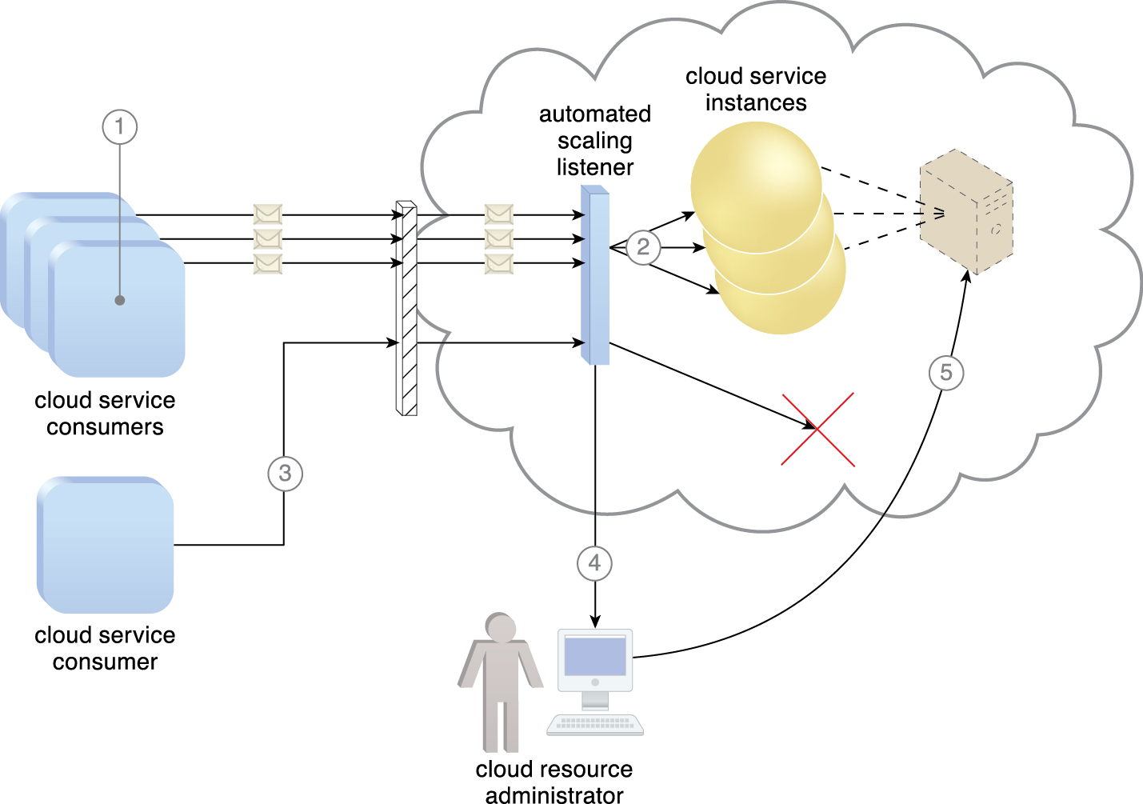
8.1. Automated Scaling Listener
Three cloud service consumers attempt to access one cloud service simultaneously (1)
The automated scaling listener scales out and initiates the creation of three redundant instances of the service (2)
A fourth cloud service consumer attempts to use the cloud service (3)
Programmed to allow up to only three instances of the cloud service, the automated scaling listener rejects the fourth attempt and notifies the cloud consumer that the requested workload limit has been exceeded (4)
The cloud consumer’s cloud resource administrator accesses the remote administration environment to adjust the provisioning setup and increase the redundant instance limit (5).
Figure 8.1
Notes:
Figure:

Slide 6
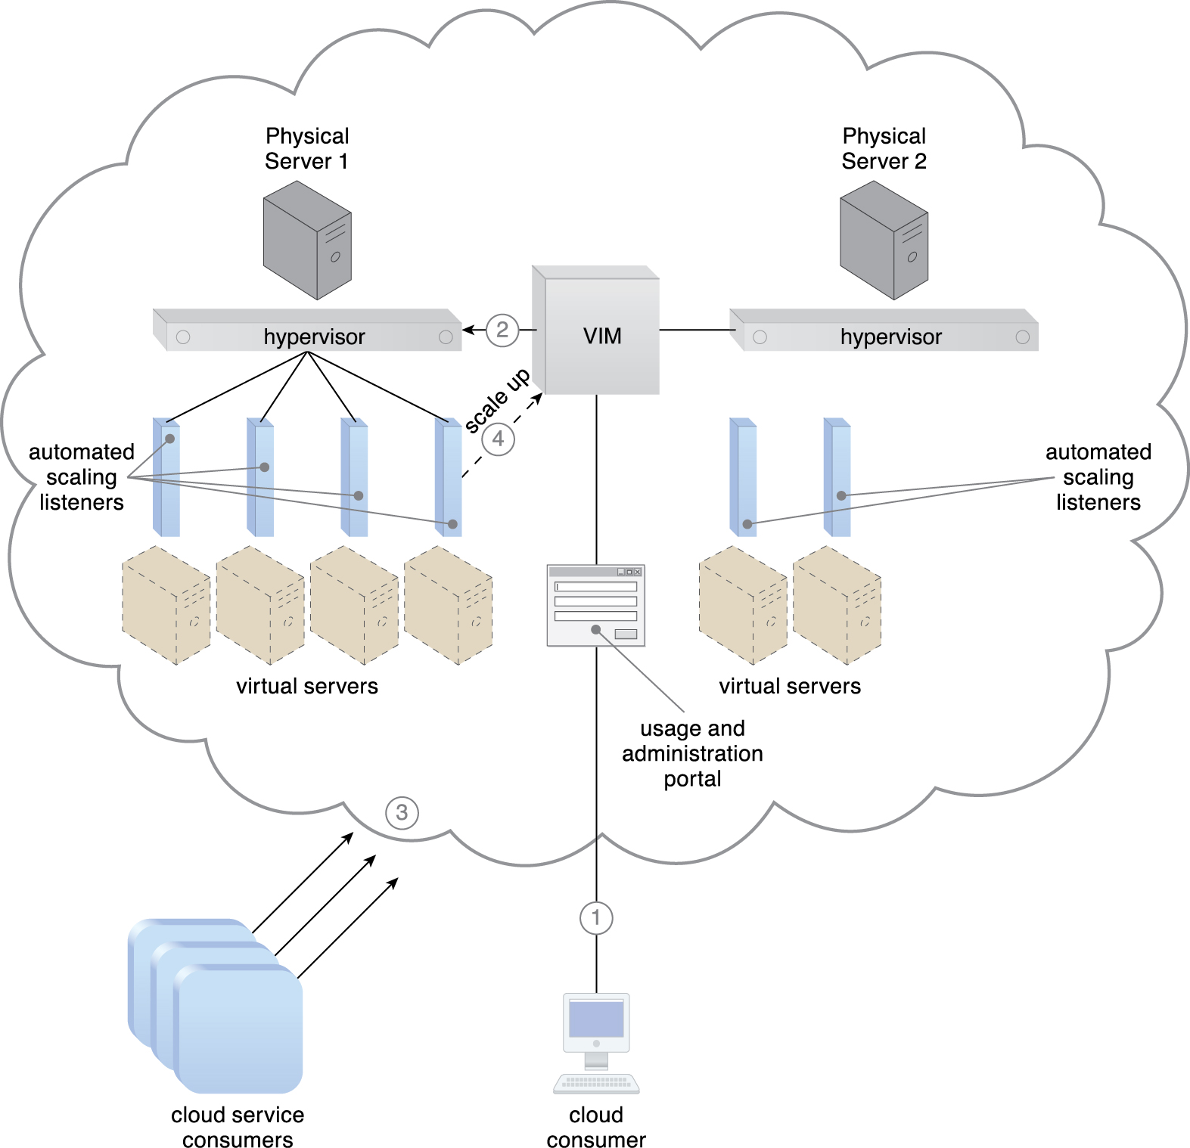
8.1. Automated Scaling Listener - Case Study Example
A cloud consumer creates and starts a virtual server with 8 virtual processor cores and 16 GB of virtual RAM (1)
The VIM creates the virtual server at the cloud service consumer’s request and allocates it to Physical Server 1 to join 3 other active virtual servers (2)
Cloud consumer demand causes the virtual server usage to increase by over 80% of the CPU capacity for 60 consecutive seconds (3)
The automated scaling listener running at the hypervisor detects the need to scale up and commands the VIM accordingly (4).
Figure 8.2
Notes:
Figure:

Slide 7
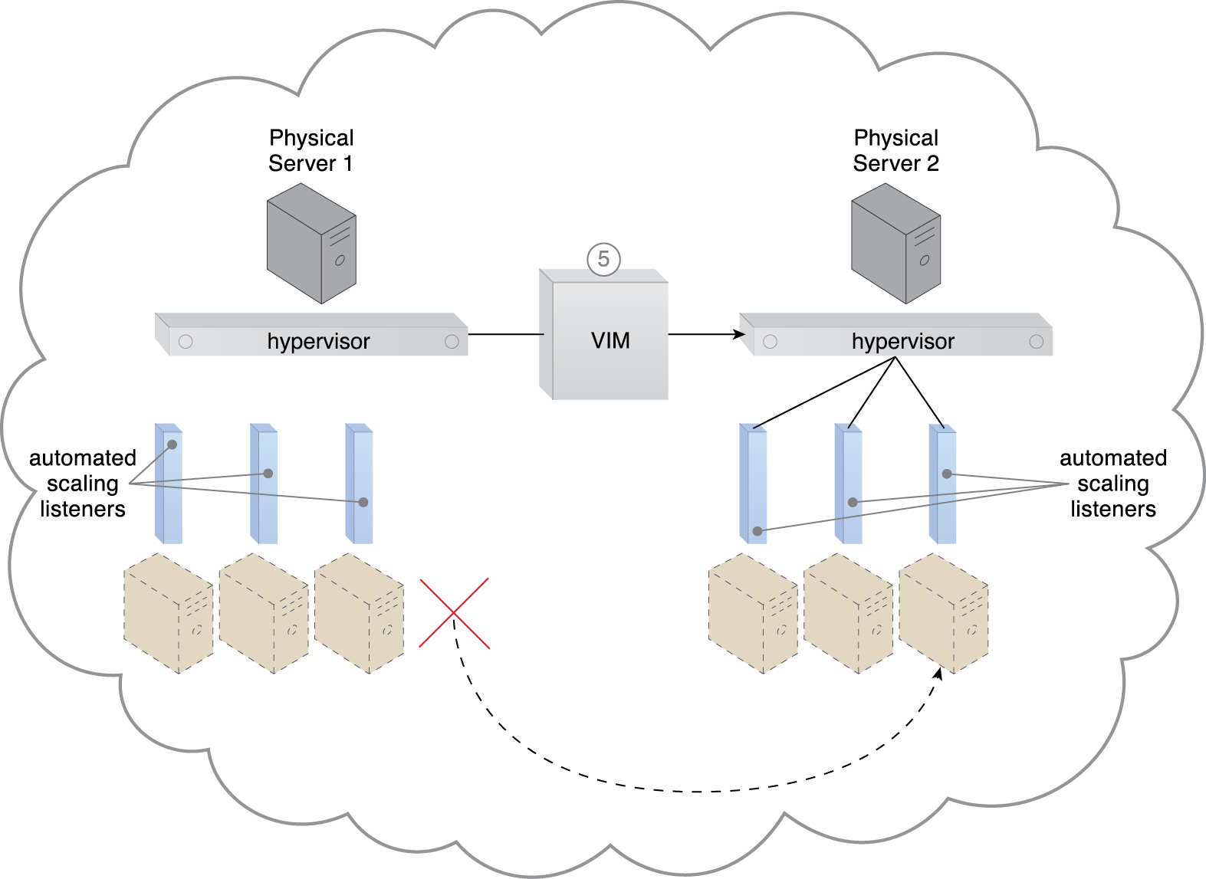
8.1. Automated Scaling Listener - Case Study Example
The VIM determines that scaling up the virtual server on Physical Server 1 is not possible and proceeds to live migrate it to Physical Server 2 (5)
Figure 8.3
Notes:
Figure:

Slide 8
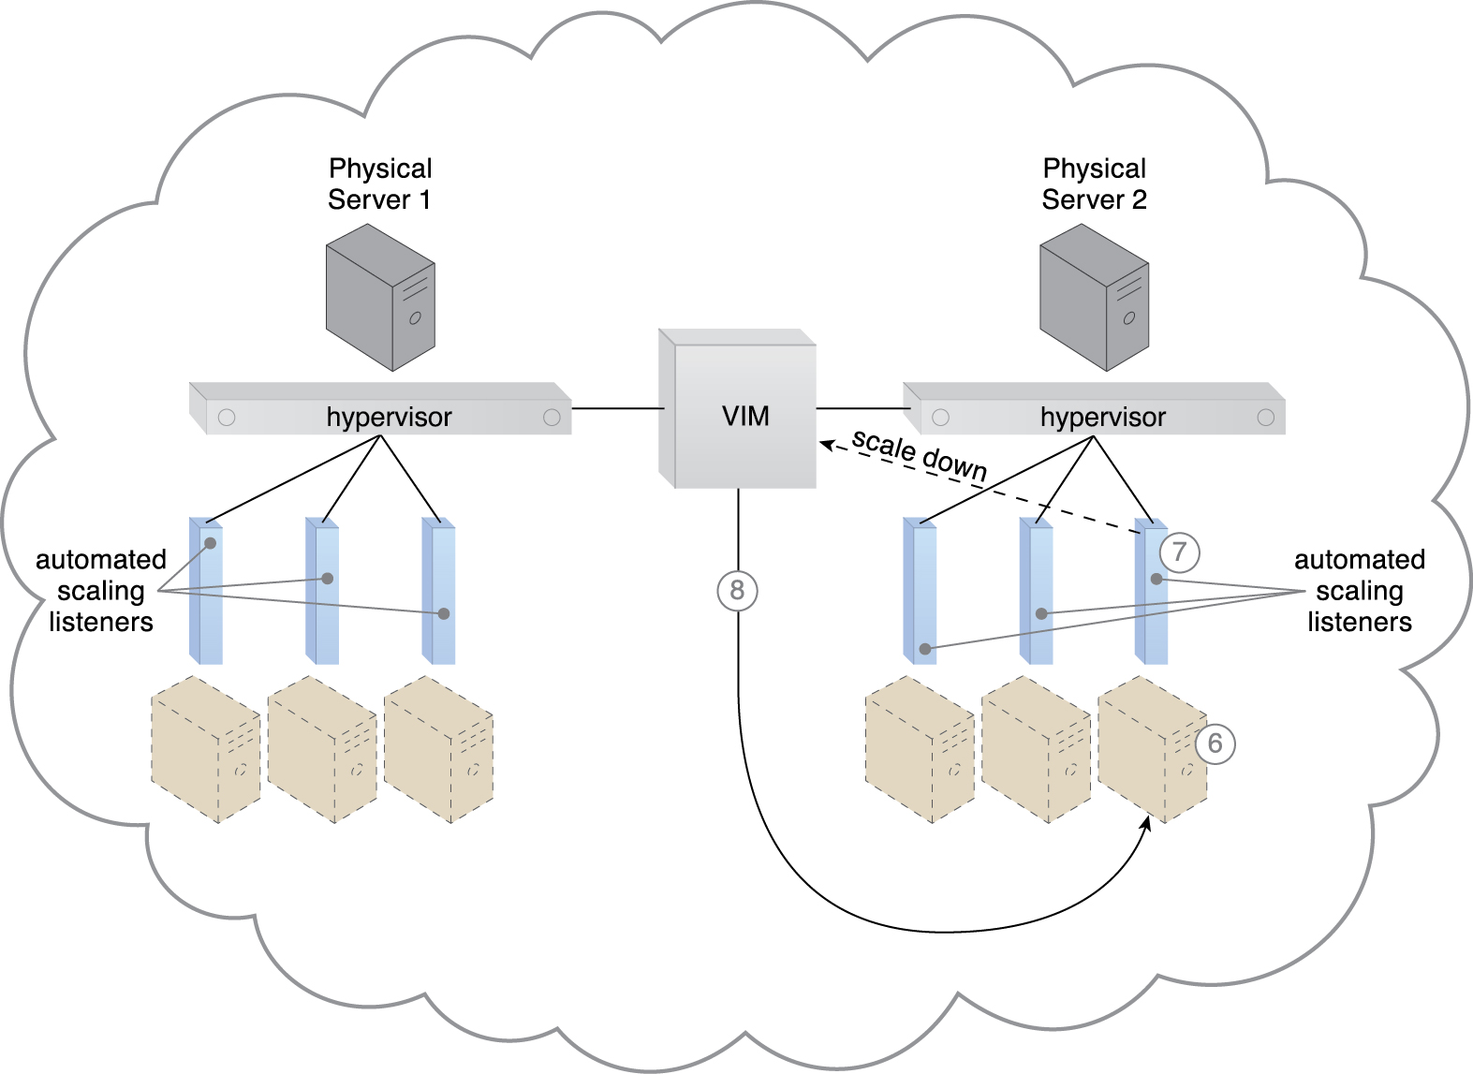
8.1. Automated Scaling Listener - Case Study Example
The virtual server’s CPU/RAM usage remains below 15% capacity for 60 consecutive seconds (6)
The automated scaling listener detects the need to scale down and commands the VIM (7)
Which scales down the virtual server (8) while it remains active on Physical Server 2.
Figure 8.4
Notes:
Figure:

Slide 9
8.2. Load Balancer
A common approach to horizontal scaling is to balance a workload across two or more IT resources to increase performance and capacity beyond what a single IT resource can provide
The load balancer mechanism is a runtime agent with logic fundamentally based on this premise.
Beyond simple division of labor algorithms, load balancers can perform a range of specialized runtime workload distribution functions that include:
Asymmetric Distribution – larger workloads are issued to IT resources with higher processing capacities
Workload Prioritization – workloads are scheduled, queued, discarded, and distributed according to their priority levels
Content-Aware Distribution – requests are distributed to different IT resources as dictated by the request content

Slide 10
8.2. Load Balancer
A load balancer is programmed or configured with a set of performance, QoS rules and parameters with the general objectives of optimizing IT resource usage, avoiding overloads, and maximizing throughput.
The load balancer mechanisms can exist as a:
multi-layer network switch
dedicated hardware appliance
dedicated software-based system (common in server operating systems)
service agent (usually controlled by cloud management software)
The load balancer is typically located on the communication path between the IT resources generating the workload and the IT resources performing the workload processing
This mechanism can be designed to be hidden from the cloud service consumers, or as a proxy component that abstracts the IT resources performing their workload

Slide 11
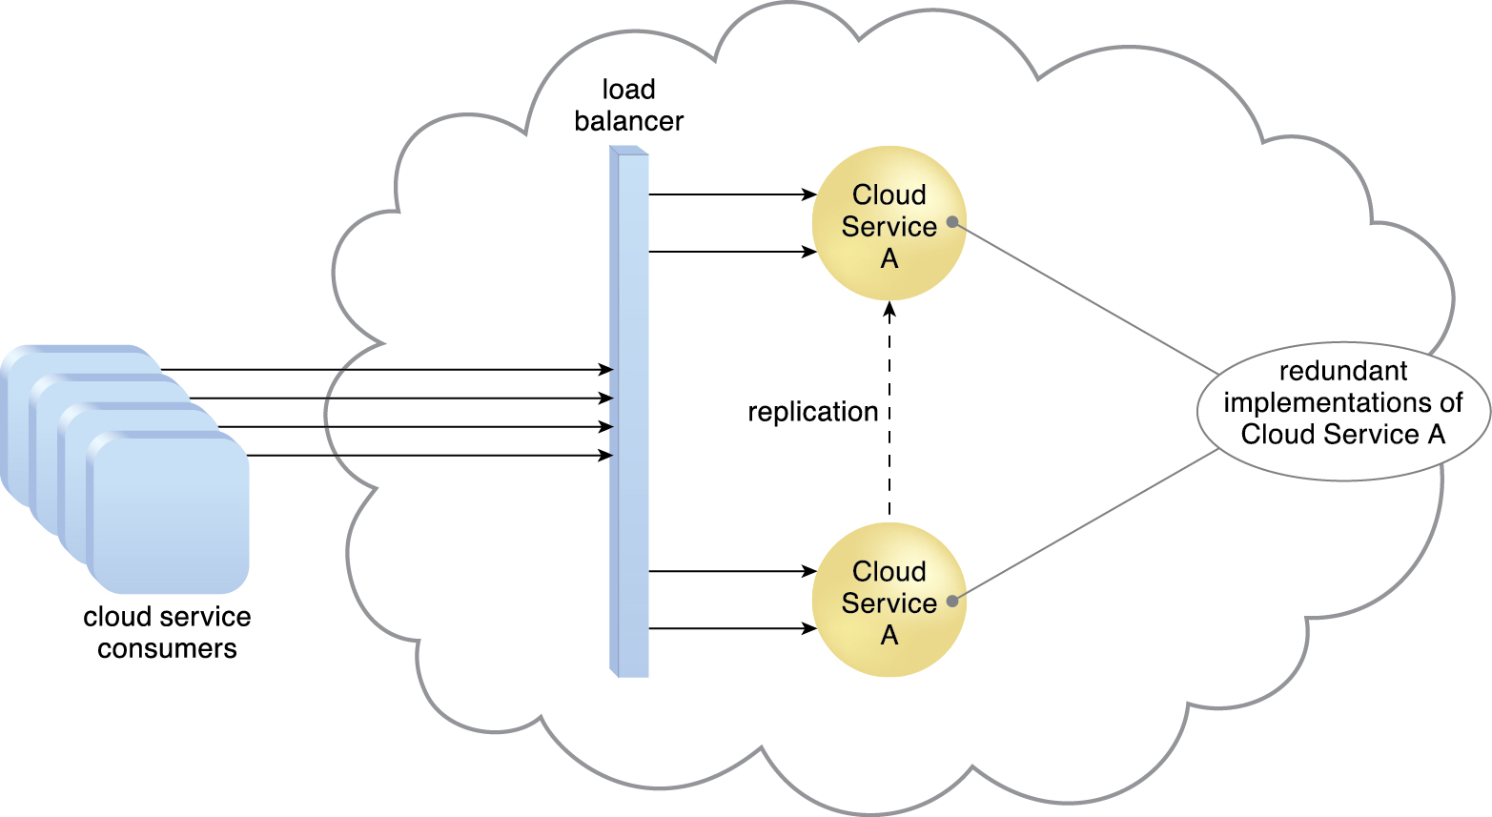
8.2. Load Balancer
A load balancer implemented as a service agent transparently distributes incoming workload request messages across two redundant cloud service implementations, which in turn maximizes performance for the cloud service consumers.
Figure 8.5
Notes:
Figure:

Slide 12
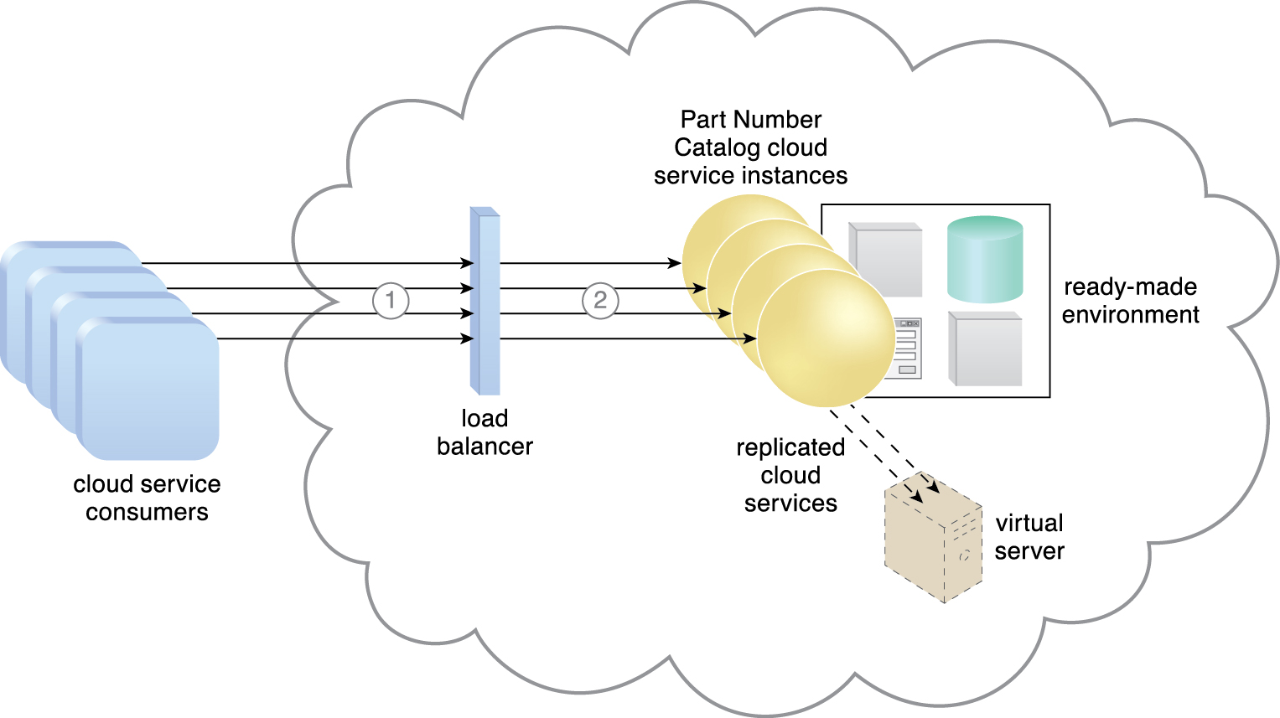
8.2. Load Balancer - Case Study Example
For ATN, a robot automation testing tool that simulates heavy workloads. The tests need to determine whether the application can seamlessly scale to serve peak workloads that are 1,000 times greater than their average workloads
New instances of the cloud services are automatically created to meet increasing usage requests (1)
The load balancer uses round-robin scheduling to ensure that the traffic is distributed evenly among the active cloud services (2)
Figure 8.6
Notes:
Figure:

Slide 13
8.3. SLA Monitor
The SLA monitor mechanism is used to specifically observe the runtime performance of cloud services to ensure that they are fulfilling the contractual QoS requirements that are published in SLAs
The data collected by the SLA monitor is processed by an SLA management system to be aggregated into SLA reporting metrics
The system can proactively repair or failover cloud services when exception conditions occur, such as when the SLA monitor reports a cloud service as “down.”

Slide 14
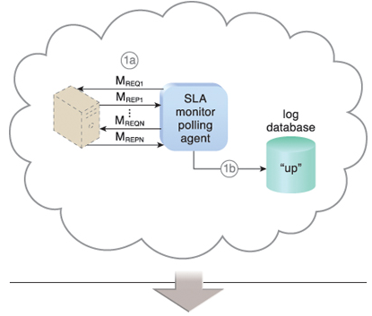
8.3. SLA Monitor
The SLA monitor polls the cloud service by sending over polling request messages (M_{REQ1} to M_{REQN}).
The monitor receives polling response messages (M_{REP1} to M_{REPN}) that report that the service was “up” at each polling cycle (1a)
The SLA monitor stores the “up” time—time period of all polling cycles 1 to N—in the log database (1b).
Figure 8.7
Notes:
Figure:

Slide 15
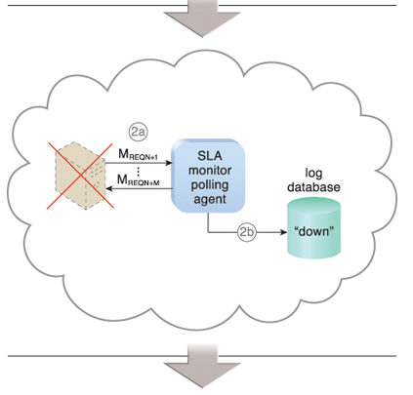
8.3. SLA Monitor
The SLA monitor polls the cloud service that sends polling request messages (M_{REQN+1} to M_{REQN+M}).
Polling response messages are not received (2a)
The response messages continue to time out, so the SLA monitor stores the “down” time—time period of all polling cycles N+1 to N+M—in the log database (2b)
Figure 8.7
Notes:
Figure:

Slide 16
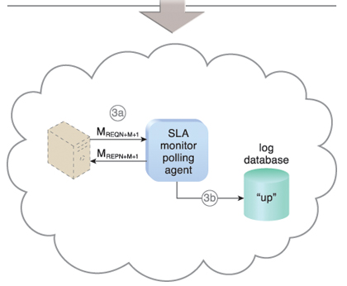
8.3. SLA Monitor
The SLA monitor sends a polling request message (M_{REQN+M+1}) and receives the polling response message (M_{REPN+M+1}) (3a)
The SLA monitor stores the “up” time in the log database (3b)
Figure 8.7
Notes:
Figure:

Slide 17
8.3. SLA Monitor – Case Study Example
Availability of 99.95 is tracked by two SLA Monitors
one based on a polling agent
the other based on a regular monitoring agent implementation
SLA Monitor Polling Agent
Runs on external perimeter network
Detect physical server timeout
Identifies data center network, hardware, and software failures (with minute-granularity) that result in physical server non-responsiveness
3 consecutive timeout constitutes resource unavailable

Slide 18
8.3. SLA Monitor – Case Study Example
SLA Monitor Polling Agent generated events
PS_Timeout – the physical server polling has timed out
PS_Unreachable – the physical server polling has consecutively timed out three times
PS_Reachable – the previously unavailable physical server becomes responsive to polling again
SLA Monitoring Agent
The VIM’s event-driven API implements the SLA monitor as a monitoring agent to generate the following three events:
VM_Unreachable – the VIM cannot reach the VM
VM Failure – the VM has failed and is unavailable
VM_Reachable – the VM is reachable

Slide 19
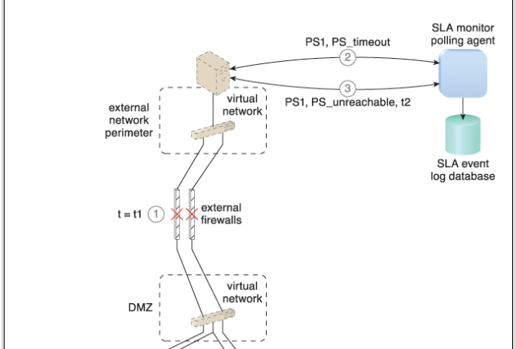
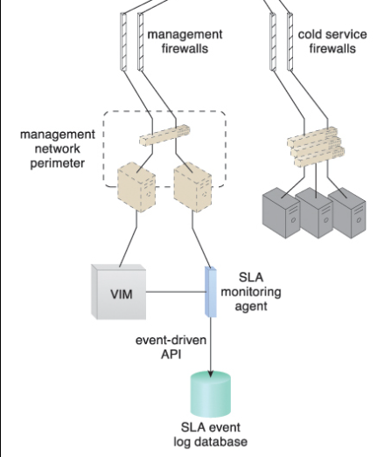
8.3. SLA Monitor – Case Study Example
Figure 8.8

Slide 20
8.3. SLA Monitor – Case Study Example
Figure 8.8 At timestamp = t1, a firewall cluster has failed and all of the IT resources in the data center become unavailable (1).
The SLA monitor polling agent stops receiving responses from physical servers and starts to issue PS_timeout events (2).
The SLA monitor polling agent starts issuing PS_unreachable events after three successive PS_timeout events. The timestamp is now t2 (3).

Slide 21
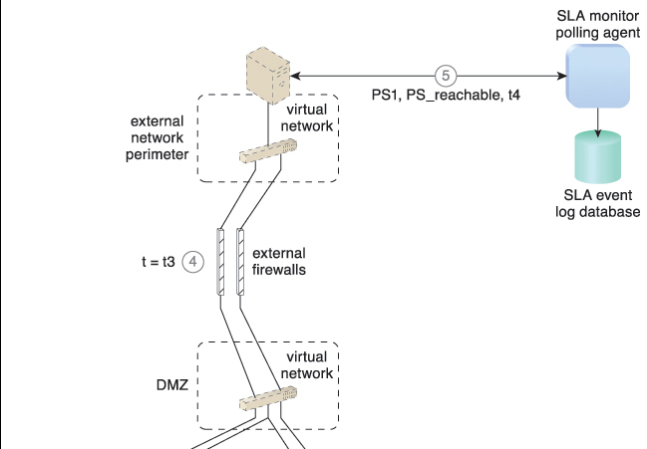
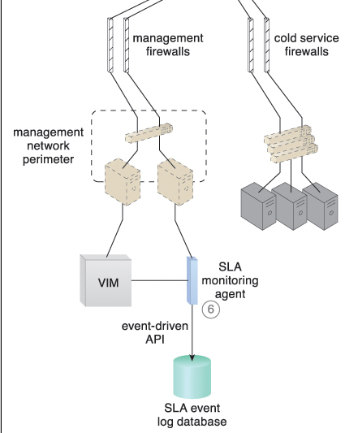
8.3. SLA Monitor – Case Study Example
Figure 8.9

Slide 22
8.3. SLA Monitor – Case Study Example
Figure 8.9 The IT resource becomes operational at timestamp = t3 (4).
The SLA monitor polling agent receives responses from the physical servers and issues PS_reachable events. The timestamp is now t4 (5).
The SLA monitoring agent did not detect any unavailability since the communication between the VIM platform and physical servers was not affected by the failure (6).
Unavailability period is t4 – t3.

Slide 23
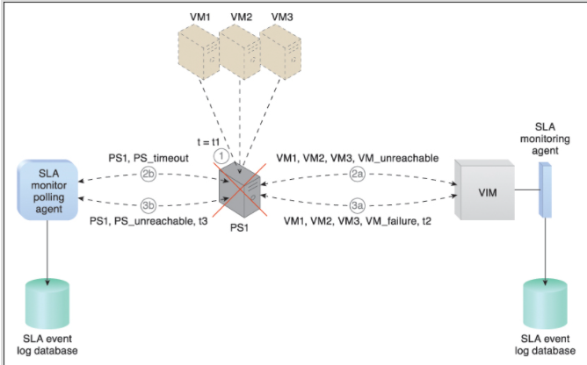
8.3. SLA Monitor – Case Study Example
Figures 8.10 illustrate the steps that are taken by the SLA monitors during the failure of a physical server that is hosting three virtual servers (VM1, VM2, VM3).
At timestamp = t1, the physical host server has failed and becomes unavailable (1).
The SLA monitoring agent captures a VM_unreachable event that is generated for each virtual server in the failed host server (2a).

Slide 24
8.3. SLA Monitor – Case Study Example
Figures 8.10 The SLA monitor polling agent stops receiving responses from the host server and issues PS_timeout events (2b).
At timestamp = t2, the SLA monitoring agent captures a VM_failure event that is generated for each of the failed host server’s three virtual servers (3a).
The SLA monitor polling agent starts to issue PS_unavailable events after three successive PS_timeout events at timestamp = t3 (3b).

Slide 25
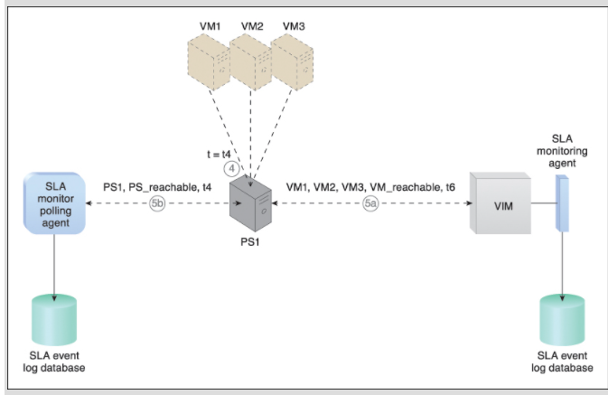
8.3. SLA Monitor – Case Study Example
Figures 8.11 Recovery.
The host server becomes operational at timestamp = t4 (4).
The SLA monitor polling agent receives responses from the physical server and issues PS_reachable events at timestamp = t5 (5b).
At timestamp = t6, the SLA monitoring agent captures a VM_reachable event that is generated for each virtual server (5a).
The SLA management system calculates the unavailability period that affected all of the virtual servers as t6 – t2

Slide 26
8.4. Pay-Per-Use Monitor
The pay-per-use monitor mechanism measures cloud-based IT resource usage in accordance with predefined pricing parameters and generates usage logs for fee calculations and billing purposes.
Some typical monitoring variables are:
request/response message quantity
transmitted data volume
bandwidth consumption
The data collected by the pay-per-use monitor is processed by a billing management system that calculates the payment fees

Slide 27
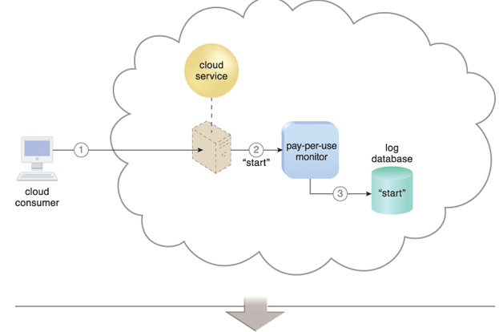
8.4. Pay-Per-Use Monitor
A cloud consumer requests the creation of a new instance of a cloud service (1).
The IT resource is instantiated and the pay-per-use monitor receives a “start” event notification from the resource software (2)
The pay-per-use monitor stores the value timestamp in the log database (3)
Figure 8.12
Notes:
Figure:

Slide 28
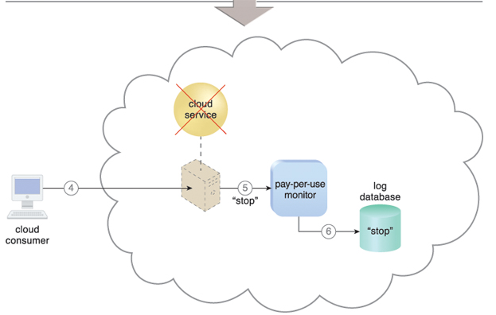
8.4. Pay-Per-Use Monitor
The cloud consumer later requests that the cloud service instance be stopped (4)
The pay-per-use monitor receives a “stop” event notification from the resource software (5)
and stores the value timestamp in the log database (6).
Figure 8.12
Notes:
Figure:

Slide 29
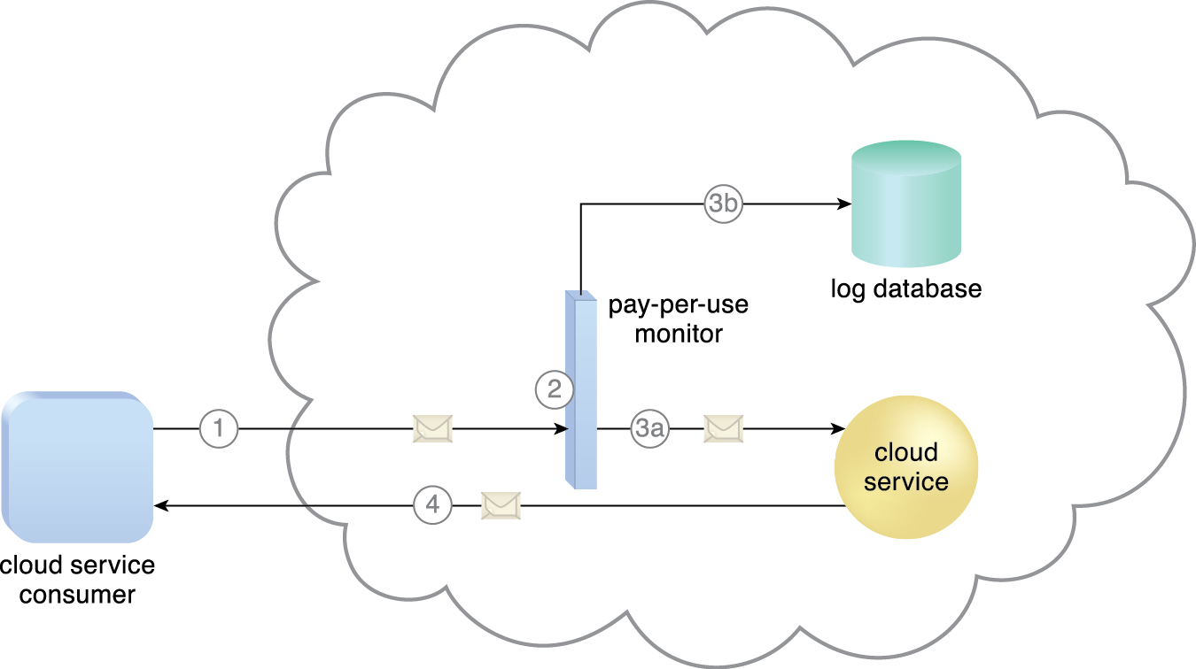
8.4. Pay-Per-Use Monitor
A cloud service consumer sends a request message to the cloud service (1)
The pay-per-use monitor intercepts the message (2)
forwards it to the cloud service (3a)
and stores the usage information in accordance with its monitoring metrics (3b)
The cloud service forwards the response messages back to the cloud service consumer to provide the requested service (4).
Figure 8.13
Notes:
Figure:

Slide 30
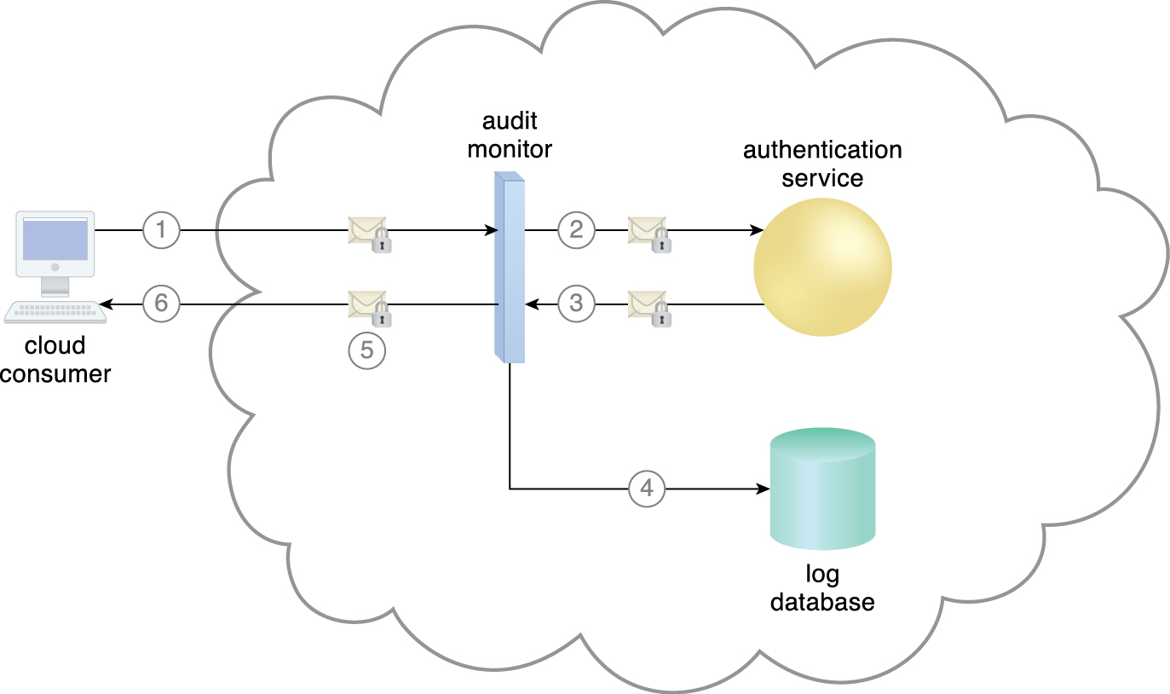
8.5. Audit Monitor
The audit monitor mechanism is used to collect audit tracking data for networks and IT resources in support of (or dictated by) regulatory and contractual obligations
A cloud service consumer requests access to a cloud service by sending a login request message with security credentials (1)
The audit monitor intercepts the message (2)
and forwards it to the authentication service (3)
The authentication service processes the security credentials
Figure 8.15
Notes:
Figure:

Slide 31
8.5. Audit Monitor
A response message is generated for the cloud service consumer, in addition to the results from the login attempt (4).
The audit monitor intercepts the response message and stores the entire collected login event details in the log database, as per the organization’s audit policy requirements (5)
Access has been granted, and a response is sent back to the cloud service consumer (6).
Figure 8.15
Notes:
Figure:

Slide 32
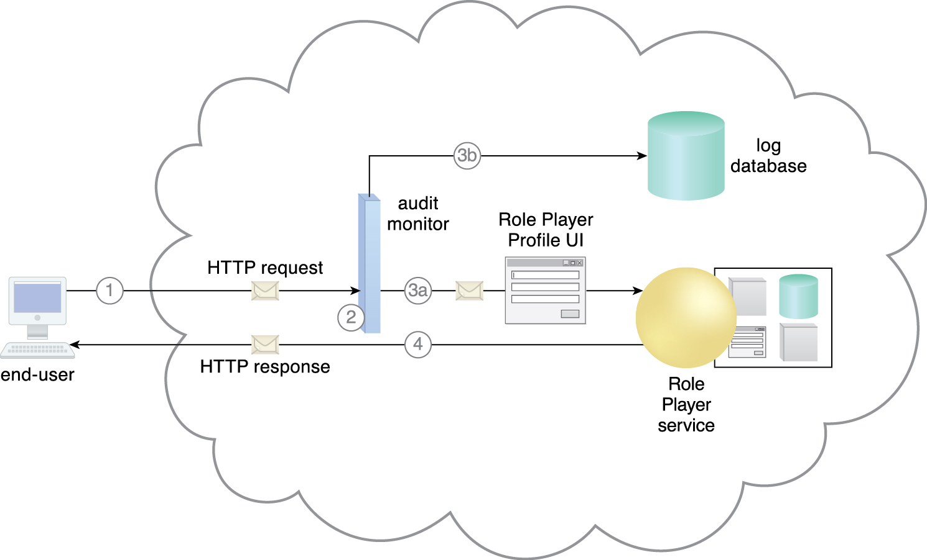
Case Study Example
Figure 8.16 An end-user attempts access to the Role Player cloud service (1).
An audit monitor transparently intercepts the HTTP request message and analyzes the message header to determine the geographical origin of the end-user (2)
The audit monitoring agent determines that the end-user is from a region that Innovartus is not authorized to charge a fee for access to the application. The agent forwards the message to the cloud service (3a)
and generates the audit track information for storage in the log database (3b)
The cloud service receives the HTTP message and grants the end-user access at no charge (4).
Notes:
Figure:

Slide 33
8.6. Failover System
The failover system mechanism
is used to increase the reliability and availability of IT resources by using established clustering technology to provide redundant implementations
is configured to automatically switch over to a redundant or standby IT resource instance whenever the currently active IT resource becomes unavailable
are commonly used for mission-critical programs and reusable services that can introduce a single point of failure for multiple applications
can span more than one geographical region so that each location hosts one or more redundant implementations of the same IT resource.
Can be configured as Active-Active or Active-Passive.
The resource replication mechanism is sometimes utilized by the failover system to provide redundant IT resource instances, which are actively monitored for the detection of errors and unavailability conditions

Slide 34
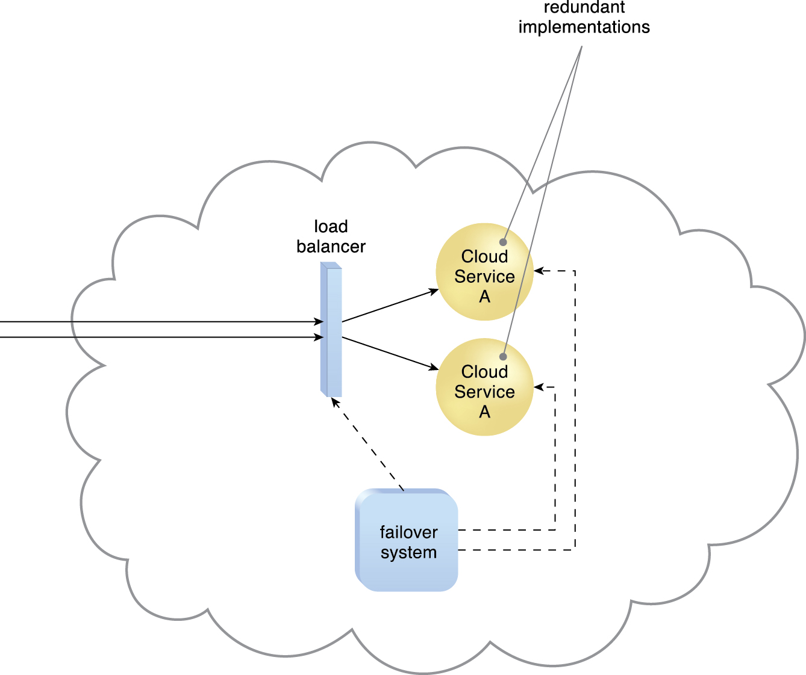
8.6. Failover System – Active/Active
In an active-active configuration, redundant implementations of the IT resource actively serve the workload synchronously
Load balancing among active instances is required
Figure 8.17 The failover system monitors the operational status of Cloud Service A.
Notes:
Figure:

Slide 35
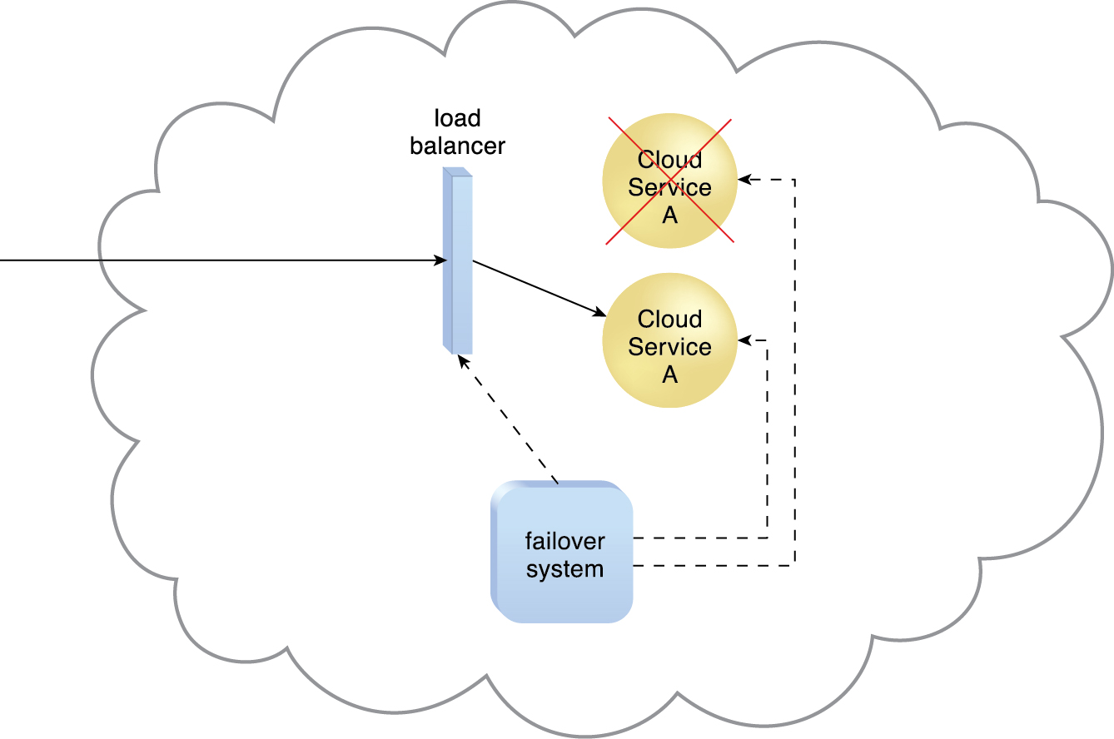
8.6. Failover System – Active/Active
When a failure is detected in one Cloud Service A implementation, the failover system commands the load balancer to switch over the workload to the redundant Cloud Service A implementation.
Figure 8.18
Notes:
Figure:

Slide 36
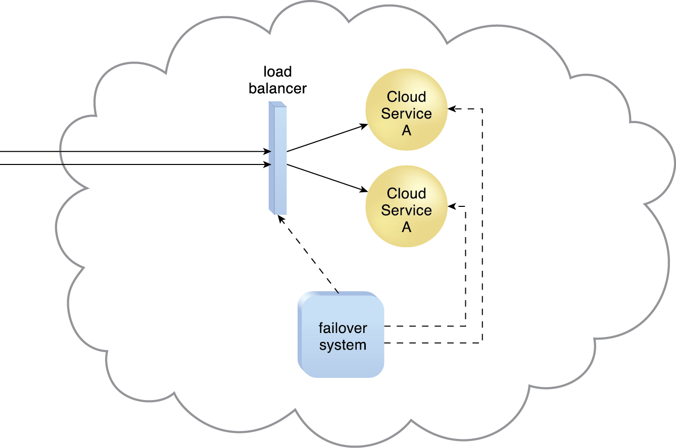
8.6. Failover System – Active/Active
The failed Cloud Service A implementation is recovered or replicated into an operational cloud service.
The failover system now commands the load balancer to distribute the workload again.
Figure 8.19
Notes:
Figure:

Slide 37
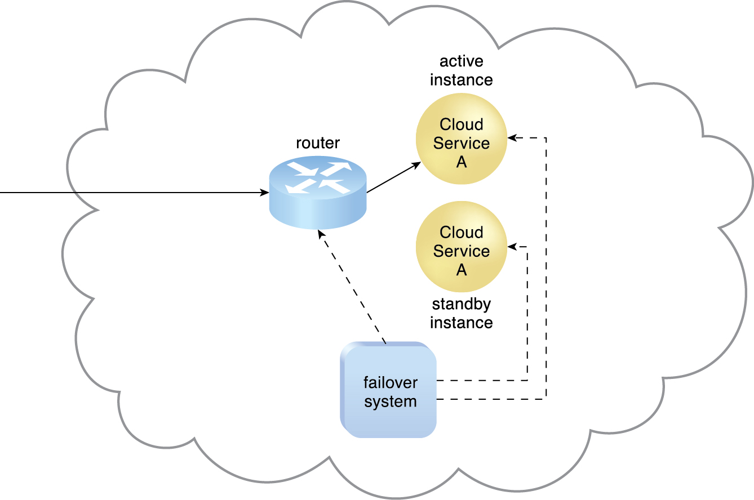
8.6. Failover System – Active/Passive
In an active-passive configuration, a standby or inactive implementation is activated to take over the processing from the IT resource that becomes unavailable, and the corresponding workload is redirected to the instance taking over the operation
The failover system monitors the operational status of Cloud Service A. The Cloud Service A implementation acting as the active instance is receiving cloud service consumer requests
Figure 8.20
Notes:
Figure:

Slide 38
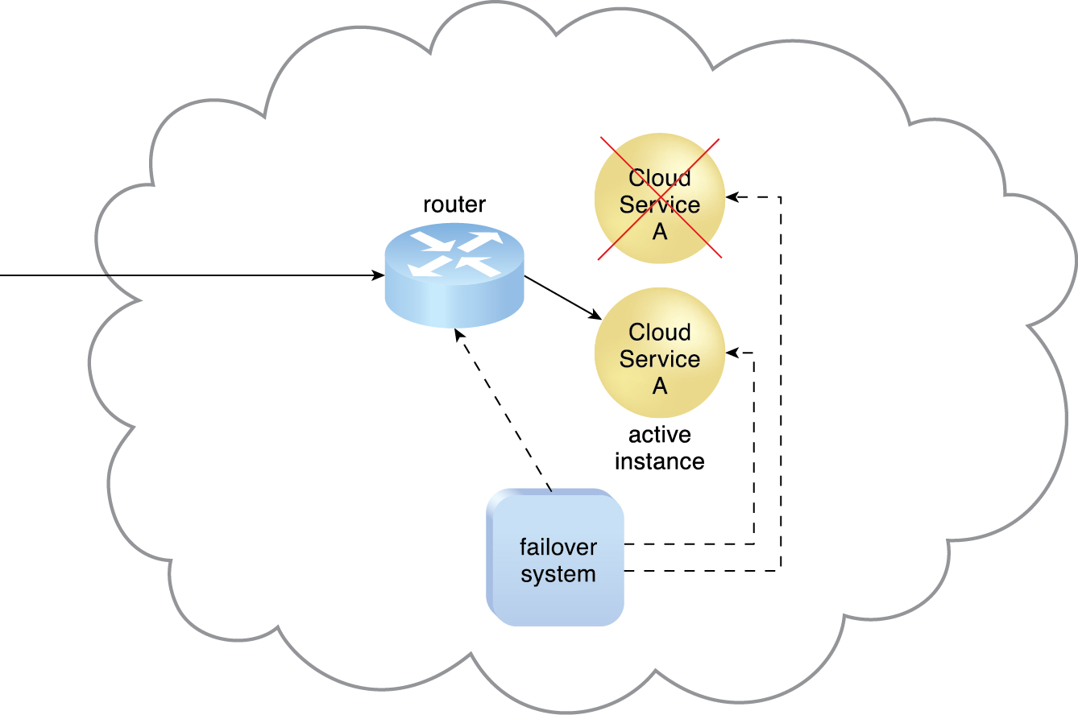
8.6. Failover System – Active/Passive
The Cloud Service A implementation acting as the active instance encounters a failure that is detected by the failover system, which subsequently activates the inactive Cloud Service A implementation and redirects the workload toward it. The newly invoked Cloud Service A implementation now assumes the role of active instance.
Figure 8.21
Notes:
Figure:

Slide 39
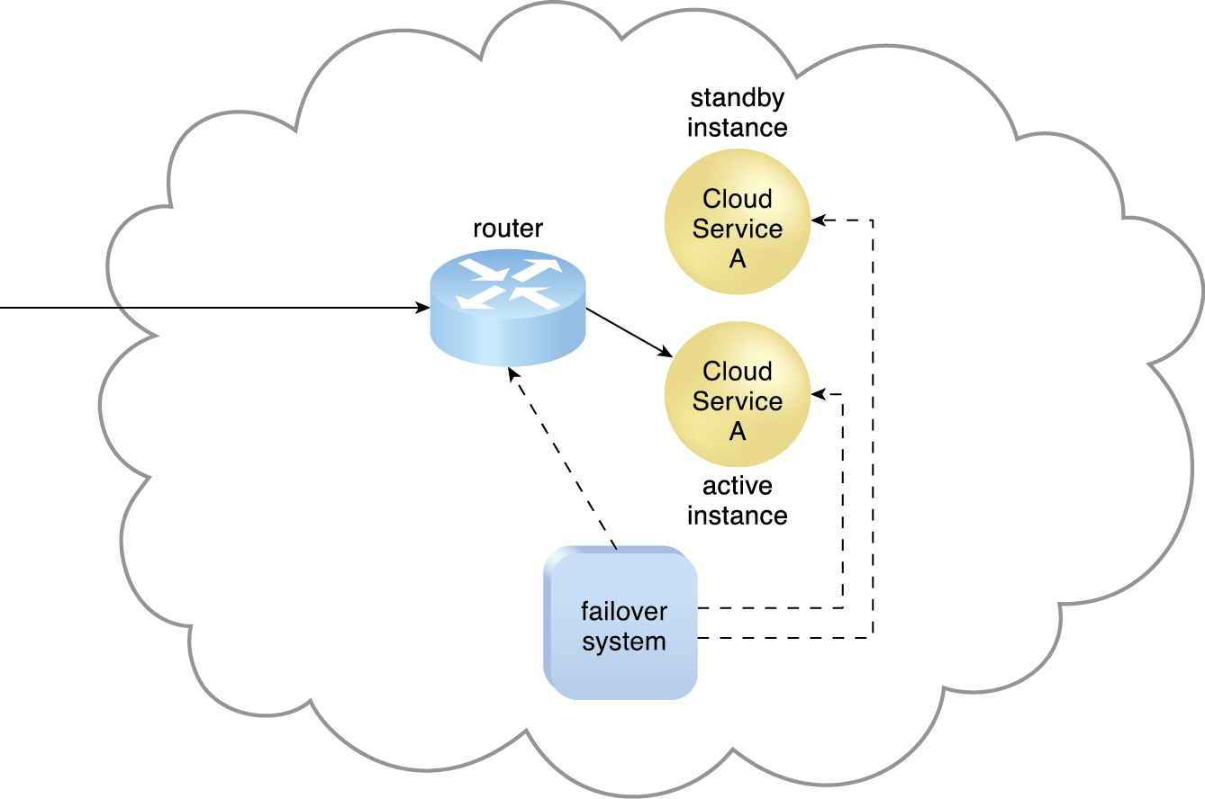
8.6. Failover System – Active/Passive
The failed Cloud Service A implementation is recovered or replicated an operational cloud service, and is now positioned as the standby instance, while the previously invoked Cloud Service A continues to serve as the active instance
Figure 8.22.
Notes:
Figure:

Slide 40
8.7. Hypervisor
The hypervisor mechanism
a fundamental part of virtualization infrastructure that is primarily used to generate virtual server instances of a physical server
generally limited to one physical server and can therefore only create virtual images of that server
can only assign virtual servers it generates to resource pools that reside on the same underlying physical server
has limited virtual server management features, such as increasing the virtual server’s capacity or shutting it down
can be installed directly in bare-metal servers and provides features for controlling, sharing and scheduling the usage of hardware resources, such as processor power, memory, and I/O.
These can appear to each virtual server’s operating system as dedicated resources.
The VIM provides a range of features for administering multiple hypervisors across physical servers

Slide 41
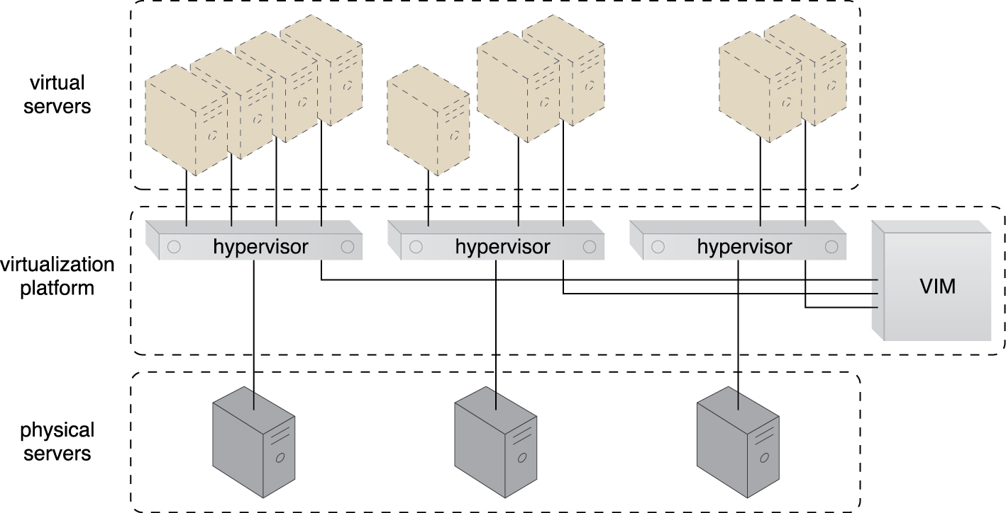
8.7. Hypervisor
Virtual servers are created via individual hypervisor on individual physical servers.
All three hypervisors are jointly controlled by the same VIM.
Figure 8.27
Notes:
Figure:

Slide 42
8.8. Resource Cluster
Cloud-based IT resources that are geographically diverse can be logically combined into groups to improve their allocation and use.
The resource cluster mechanism is used to group multiple IT resource instances so that they can be operated as a single IT resource
This increases the combined computing capacity, load balancing, and availability of the clustered IT resources
architectures rely on high-speed dedicated network connections, or cluster nodes, between IT resource instances to communicate about workload distribution, task scheduling, data sharing, and system synchronization
Notes:
Figure:

Slide 43
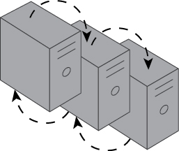
8.8. Resource Cluster
The resource cluster mechanism (cont.)
A cluster management platform that is running as distributed middleware in all nodes is usually responsible for these activities
This platform implements a coordination function that allows distributed IT resources to appear as one IT resource, and also executes IT resources inside the cluster
Figure 8.30 The curved dashed lines are used to indicate that IT resources are clustered.
Notes:
Figure:

Slide 44
8.8. Resource Cluster – Common Types
Server Cluster
Physical or virtual servers are clustered to increase performance and availability.
Hypervisors running on different physical servers can be configured to share virtual server
requires physical servers to have access to shared storage, virtual servers are able to live-migrate from one to another.
the virtualization platform suspends the execution of a given virtual server at one physical server and resumes it on another physical server
Transparent to the virtual server operating system and can be used to increase scalability by live-migrating a virtual server that is running at an overloaded physical server to another physical server that has suitable capacity

Slide 45
8.8. Resource Cluster – Common Types
Database Cluster
Designed to improve data availability, this high-availability resource cluster has a synchronization feature that maintains the consistency of data being stored at different storage devices used in the cluster.
The redundant capacity is usually based on an active-active or active-passive failover system committed to maintaining the synchronization conditions.
Large Dataset Cluster
Data partitioning and distribution is implemented so that the target datasets can be efficiently partitioned without compromising data integrity or computing accuracy
Each cluster node processes workloads without communicating with other nodes as much as in other cluster types

Slide 46
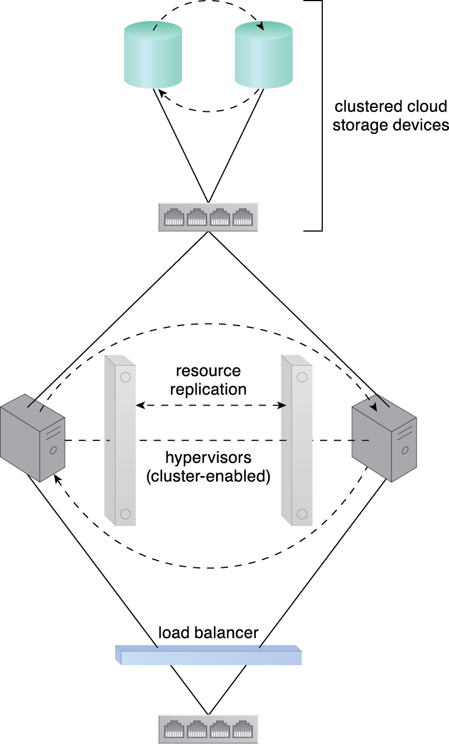
8.8. Resource Cluster
Many resource clusters require cluster nodes to have almost identical computing capacity and characteristics in order to simplify the design of and maintain consistency within the resource cluster architecture
The cluster nodes in HA cluster architectures need to access and share common storage IT resources
This can require two layers of communication between the nodes—one for accessing the storage device and another to execute IT resource orchestration
Figure 8.31
Notes:
Figure:

Slide 47
8.8. Resource Cluster
Load balancing and resource replication are implemented through a cluster-enabled hypervisor
A dedicated storage area network is used to connect the clustered storage and the clustered servers, which are able to share common cloud storage devices
This simplifies the storage replication process, which is independently carried out at the storage cluster.
Figure 8.31
Notes:
Figure:

Slide 48
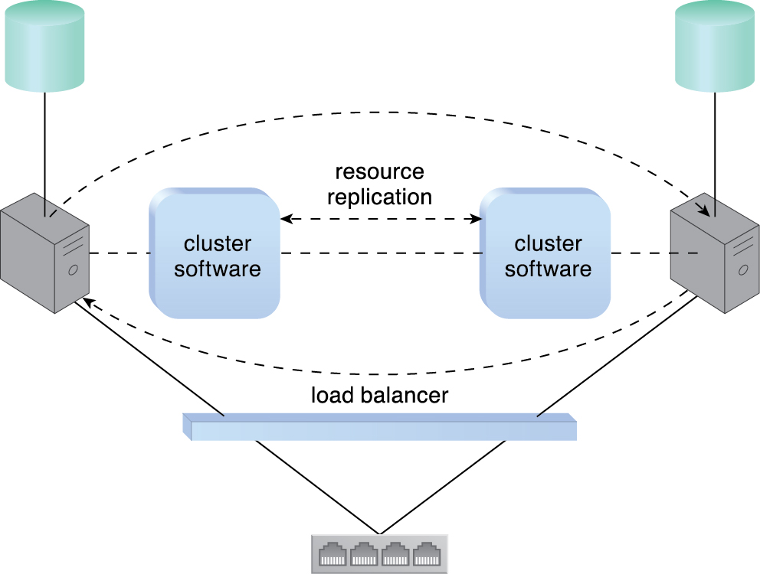
8.8. Resource Cluster
A loosely coupled server cluster that incorporates a load balancer. There is no shared storage.
Resource replication is used to replicate cloud storage devices through the network by the cluster software.
Figure 8.32
Notes:
Figure:

Slide 49
8.8. Resource Cluster
Two basic types of resource clusters
Load Balanced Cluster
This resource cluster specializes in distributing workloads among cluster nodes to increase IT resource capacity while preserving the centralization of IT resource management.
It usually implements a load balancer mechanism that is either embedded within the cluster management platform or set up as a separate IT resource.
HA Cluster
A high-availability cluster maintains system availability in the event of multiple node failures, and has redundant implementations of most or all of the clustered IT resources
It implements a failover system mechanism that monitors failure conditions and automatically redirects the workload away from any failed nodes.

Slide 50
8.9. Multi-Device Broker
An individual cloud service may need to be accessed by a range of cloud service consumers using different hardware devices and/or communication requirements
To overcome incompatibilities, mapping logic needs to be created to transform (or convert) information that is exchanged at runtime
The multi-device broker mechanism is used to facilitate runtime data transformation so as to make a cloud service accessible to a wider range of cloud service consumer programs and devices

Slide 51
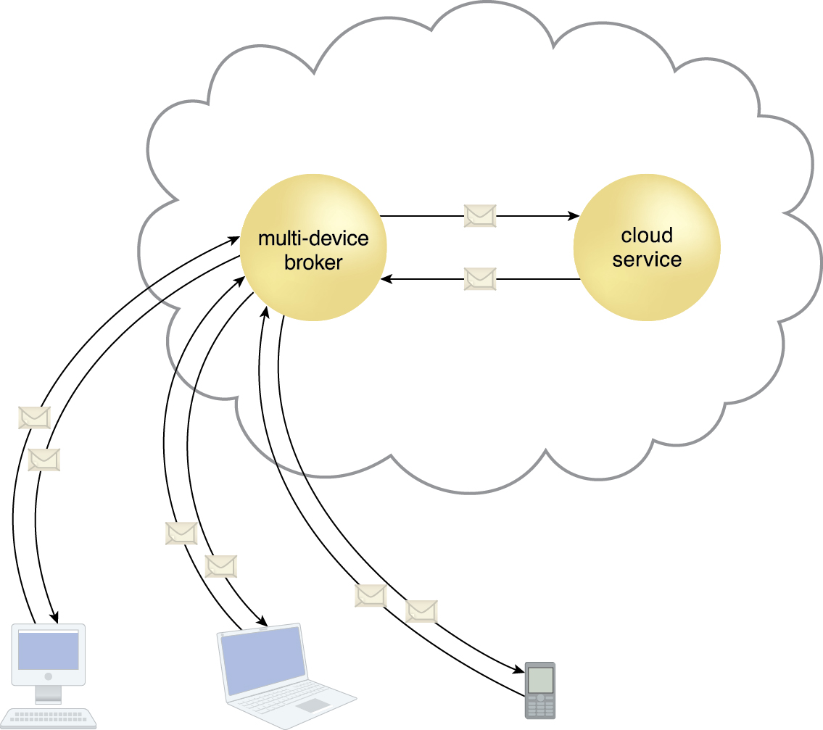
8.9. Multi-Device Broker
A multi-device broker contains the mapping logic necessary to transform data exchanges between a cloud service and different types of cloud service consumer devices.
This scenario depicts the multi-device broker as a cloud service with its own API
This mechanism can also be implemented as a service agent that intercepts messages at runtime to perform necessary transformations.
Figure 8.35
Notes:
Figure:

Slide 52
8.9. Multi-Device Broker
Multi-device brokers commonly exist as gateways or incorporate gateway components, such as:
XML Gateway – transmits and validates XML data
Cloud Storage Gateway – transforms cloud storage protocols and encodes storage devices to facilitate data transfer and storage
Mobile Device Gateway – transforms the communication protocols used by mobile devices into protocols that are compatible with a cloud service
The levels at which transformation logic can be created include:
transport protocols
messaging protocols
storage device protocols
data schemas/data models

Slide 53
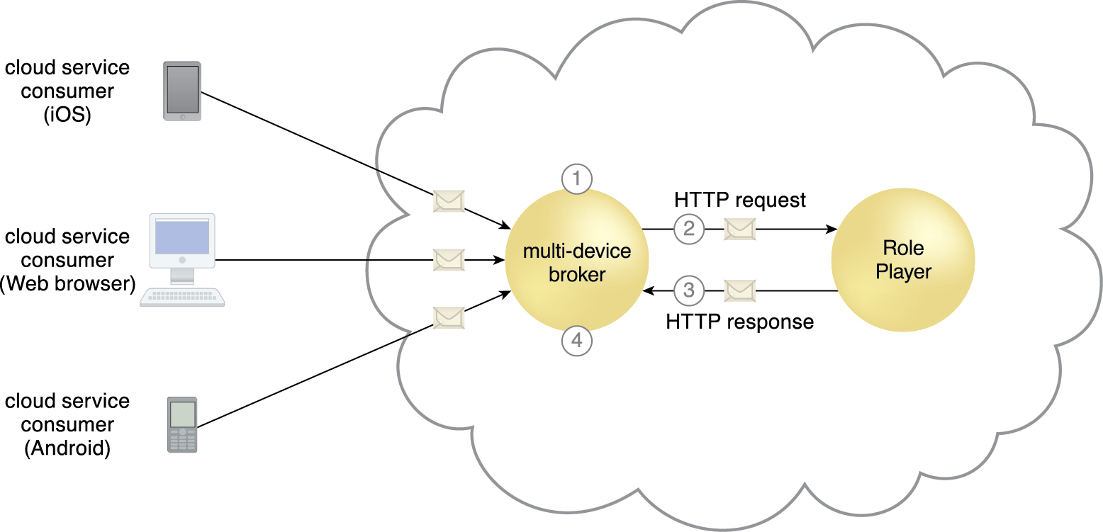
Case Study Example
The multi-device broker intercepts incoming messages and detects the platform (Web browser, iOS, Android) of the source device (1)
The multi-device broker transforms the message into the standard format required by the Innovartus cloud service (2).
The cloud service processes the request and responds using the same standard format (3).
The multi-device broker transforms the response message into the format required by the source device and delivers the message (4).
Figure 8.36
Notes:
Figure:

Slide 54
8.10. State Management Database
A state management database is a storage device that is used to temporarily persist state data for software programs
The alternative to caching state data in memory, software programs can off-load state data to the database in order to reduce the amount of runtime memory they consume
now software programs and the surrounding infrastructure are more scalable.
State management databases are commonly used by cloud services, especially those involved in long-running runtime activities
Notes:
Figure:

Slide 55
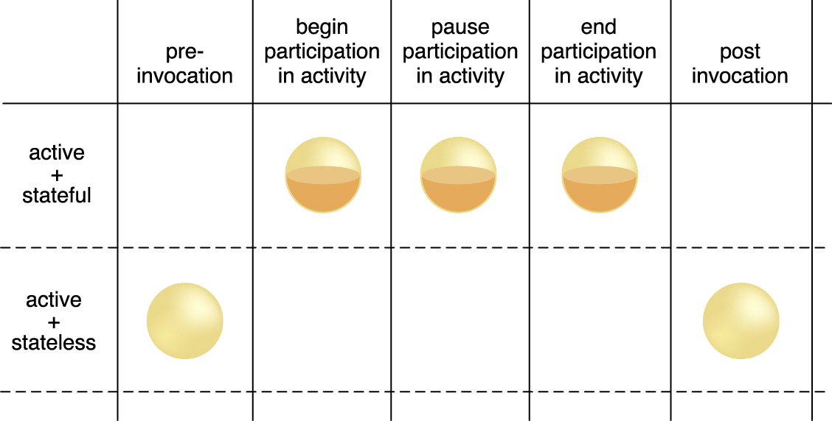
8.10. State Management Database
Figure 8.37 During the lifespan of a cloud service instance it may be required to remain stateful and keep state data cached in memory, even when idle
Notes:
Figure:

Slide 56
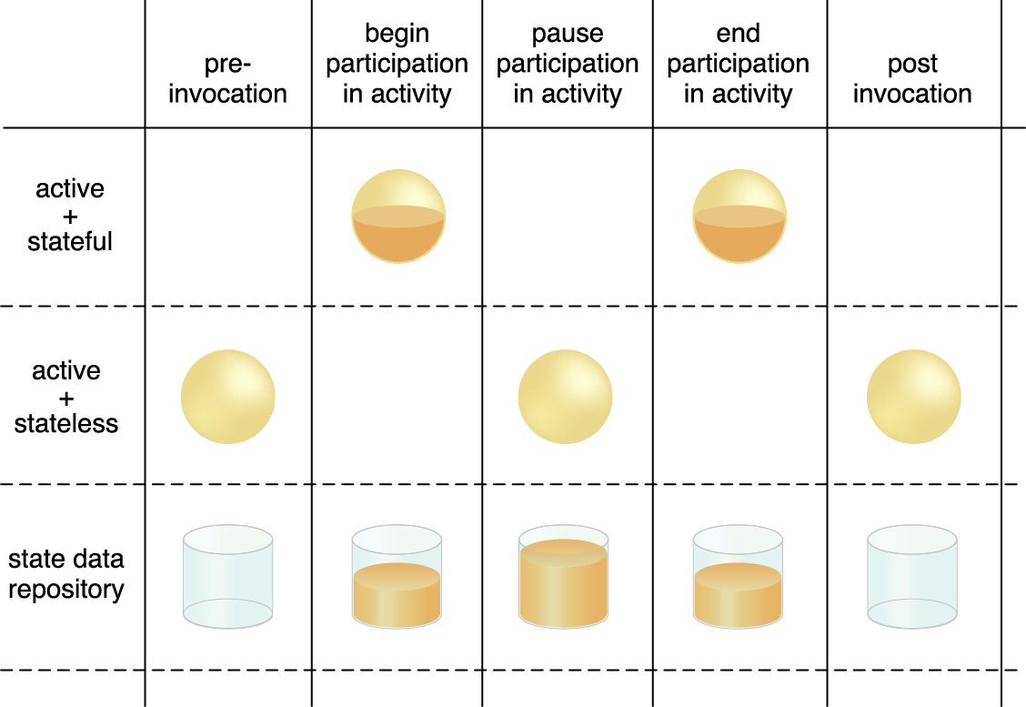
8.10. State Management Database
Figure 8.38 By deferring state data to a state repository, the cloud service is able to transition to a stateless condition (or a partially stateless condition), thereby temporarily freeing system resources
Notes:
Figure:

